Slide 1
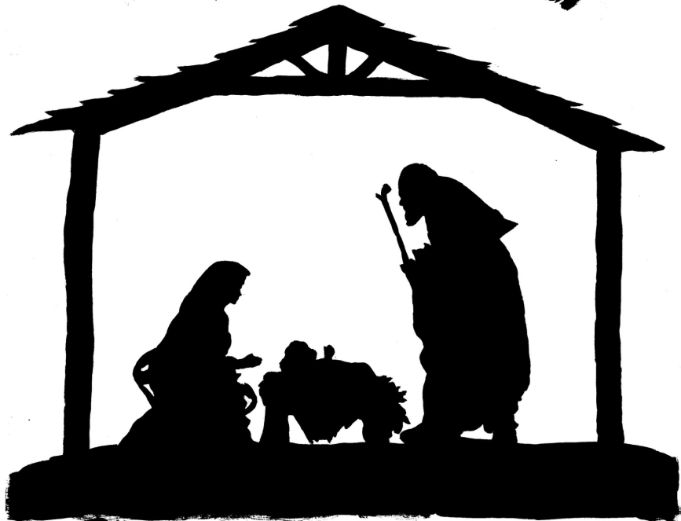
GOD’S LOVE IS EVERYWHERE
That’s What It’s All About.
In a stable cold, in a manger bed The baby Jesus lay down his sleepy head At Christmas we discover just how much God loves us all
That’s what it’s all about!
Joseph , Mary, baby Jesus (3 times)
That’s what it’s all about!

Slide 2
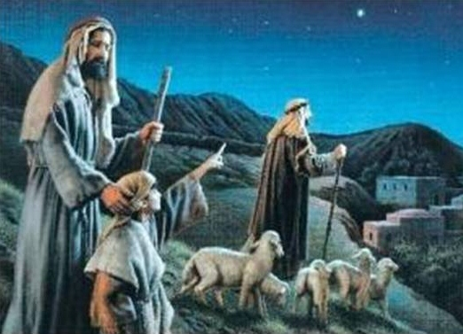
Shepherds heard the angle sing;
They hurried to the stable to see the newborn king.
At Christmas we discover just how much God loves us all
That’s what it’s all about!
Sheep, Shepherds, baby Jesus (3 times)
That’s what it’s all about!

Slide 3
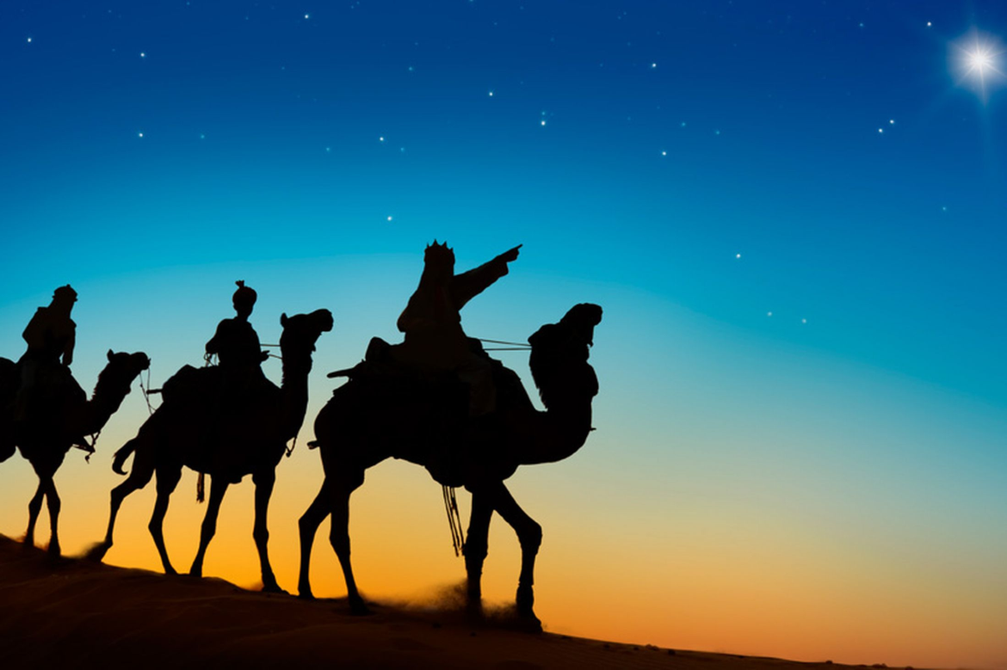
Wise men came from countries far
Bringing gifts and following a star.
At Christmas we discover just how much God loves us all
That’s what it’s all about!
Wise men, camels, baby Jesus (3 times)
THAT’S WHAT IT’S ALL ABOUT!

Slide 4
Jesus came from heaven above
Now you know the song but do you know his love?
At Christmas we discover just how much God loves us all
That’s what it’s all about!
You , me and baby Jesus(3 times)
That’s what it’s all about!

Slide 5
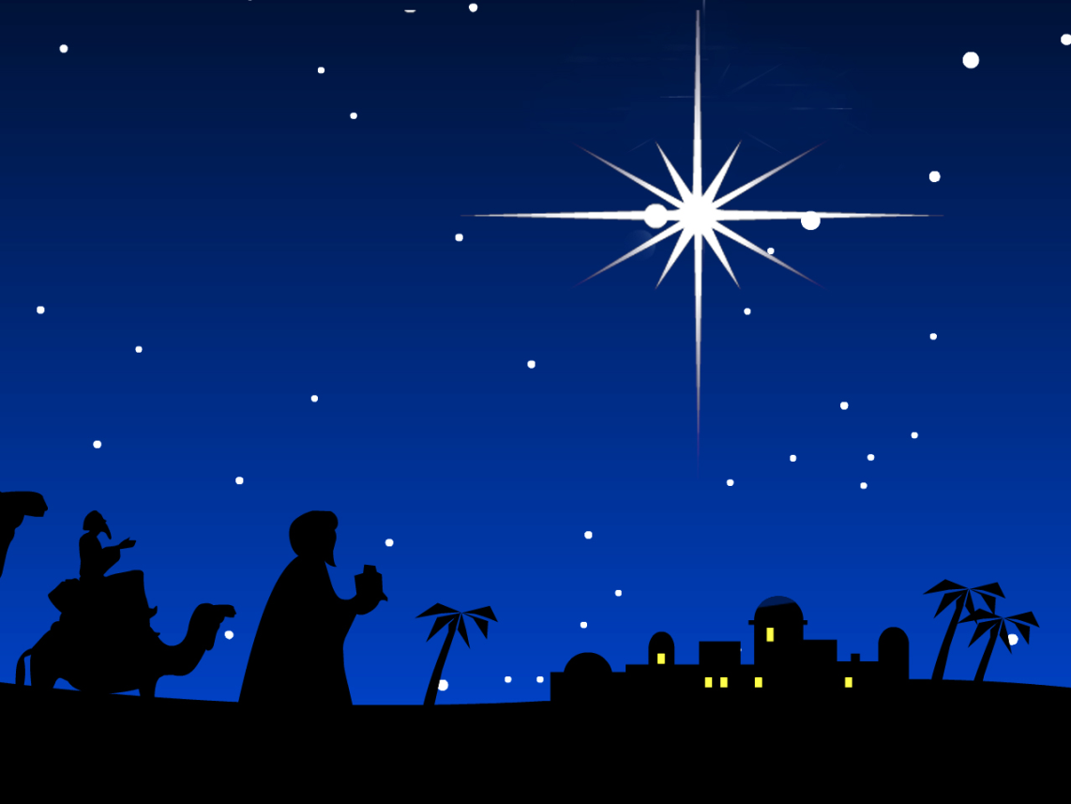
This is the stable where Jesus will lie.
This is the star that appeared in the sky.
This is the baby asleep on the hay.
Jesus was born on the first Christmas Day.

